Slide 1
Cannabis – a growing concern and a new world order SD 69 May 23, 2018

Slide 2
Outline

Slide 3
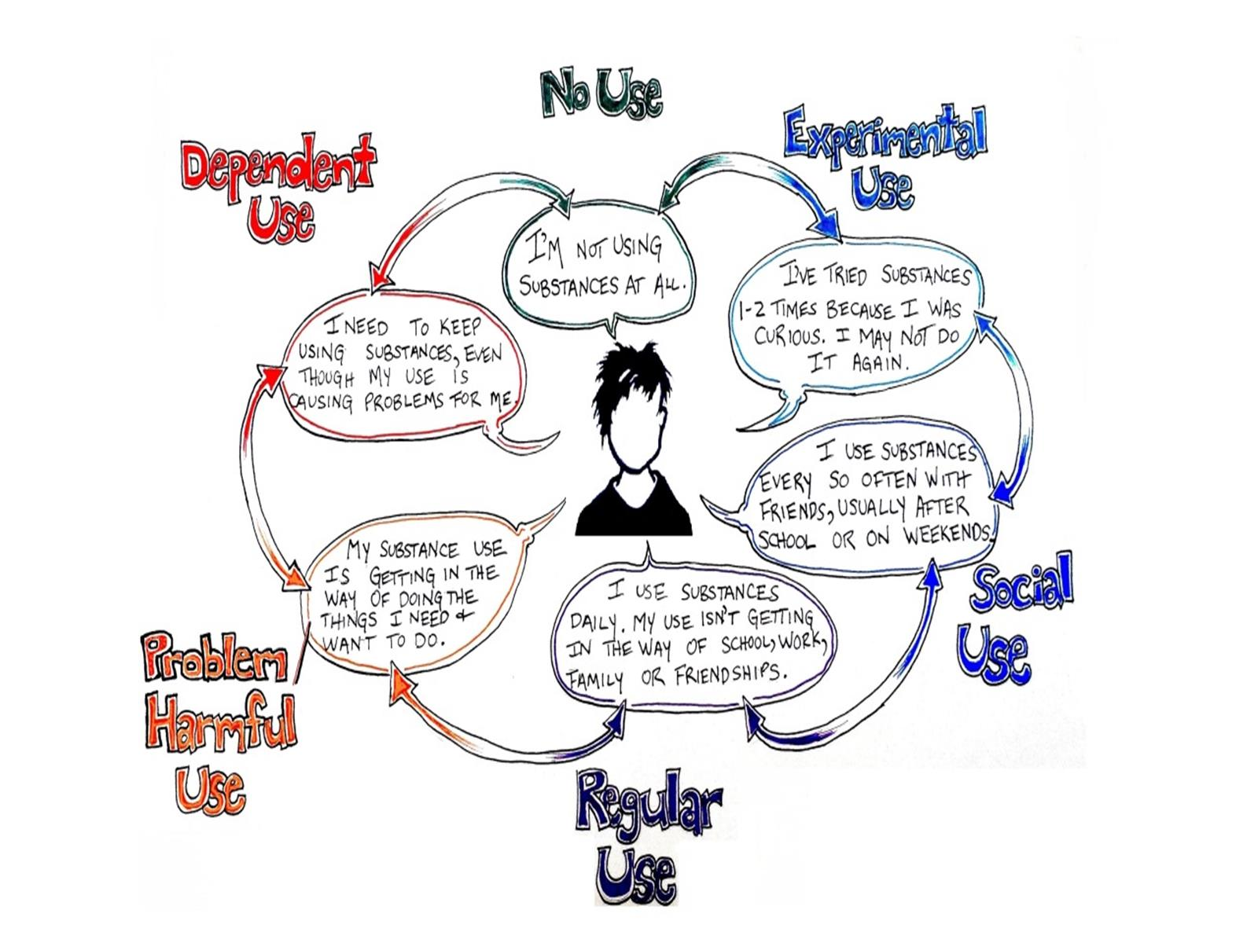

Slide 8
Medical recommendations

Slide 9
Safer use guidelines http://www.camh.ca/en/research/news_reports_and_books/Dpcuments/LRCUG.KT.Professional.15June2017.PDF

Slide 10
Legalization and youth

Slide 11
Student supports

Slide 12
School policy - suggestions

Slide 13
Managing use

Slide 14
Excessive use

Slide 15
Discovery also offers:

Slide 16
Paul Hasselback MD MSc FRCPC 250.739.6304 Medical Health Officer Central Vancouver Island paul.hasselback@viha.ca

