Slide 2
Goal 1
Diversity
To create a diverse International Student Program that expands intercultural awareness and
strong global relationships

Slide 3
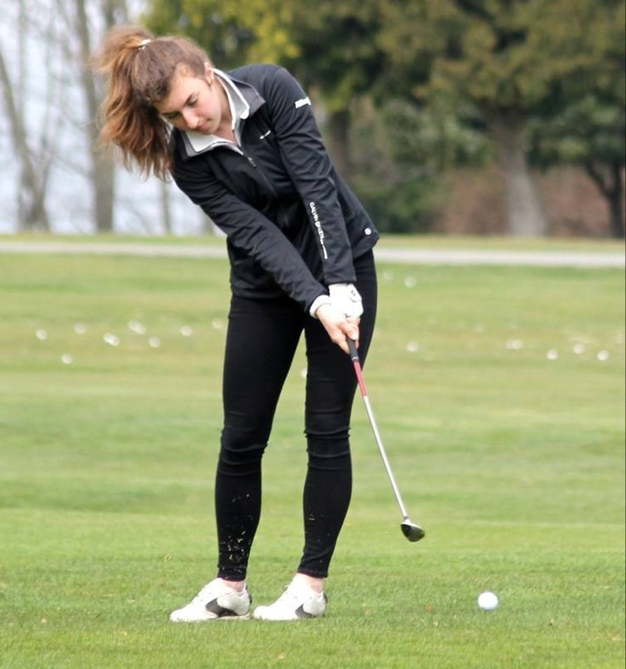
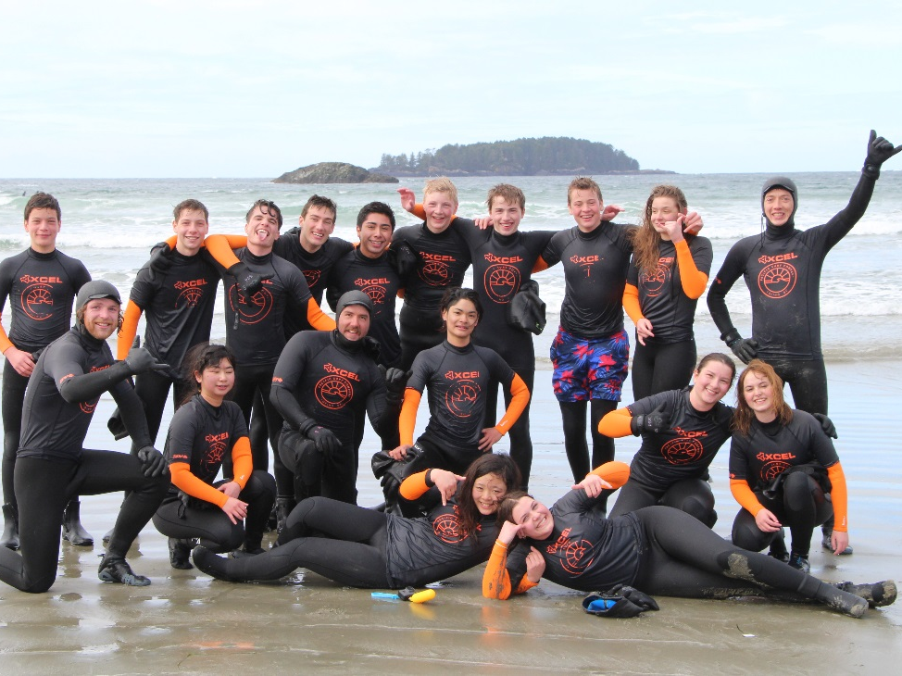
Diversification of Population
200 students from 20 different countries who study for one
semester or a full year
7 short term programs from 6 different countries
Personalization of Learning
ROAMS
Global ROAMS
Academies: - Golf - Soccer - Ice Hockey - Dance
Elective Choices

Slide 4
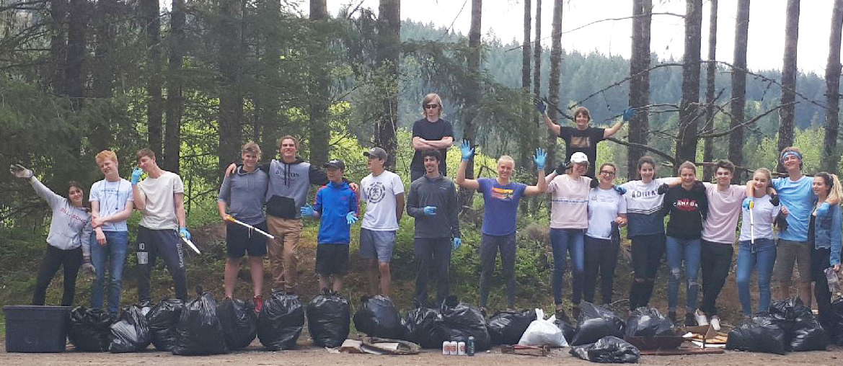
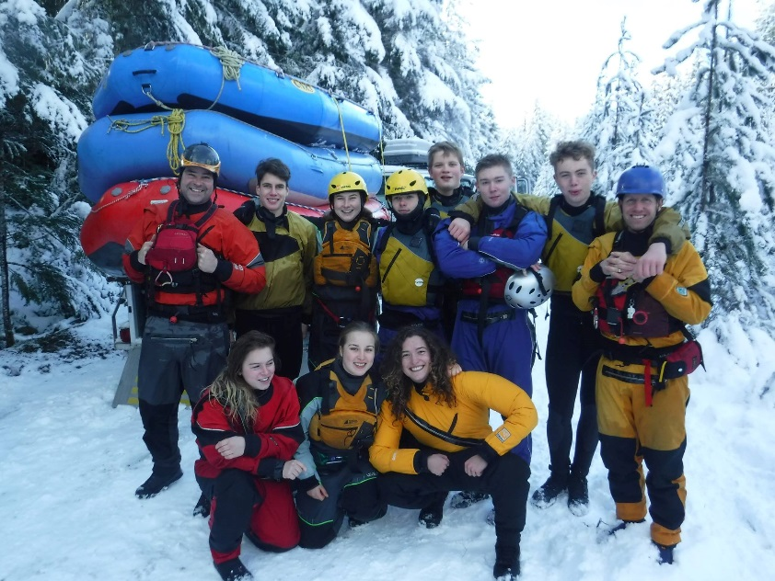
Global connections
to the curriculum
English Language Development 10
Writing 11
Transitional English and Social Studies 10
Environmental Science 11
International students interviewing Canadian adults to discover cultural connections and perspectives
Teaching historical and contemporary injustices that challenge the narrative and identity of Canada as an inclusive, multicultural society.

Slide 5
Goal 2
Fostering Relationships
To develop and maintain relationships with the school, community and global partners

Slide 6
Increase Awareness of ISP
Community events
PAC meetings
Advertising banners in the community
Liaise with Senior Management and Board of Trustees
Community Engagement
Regional District of Nanaimo programs
Pheasant Glen Golf Course
Oceanside Place
Ravensong Aquatic center
Introduction of RCMP liaison officer

Slide 7
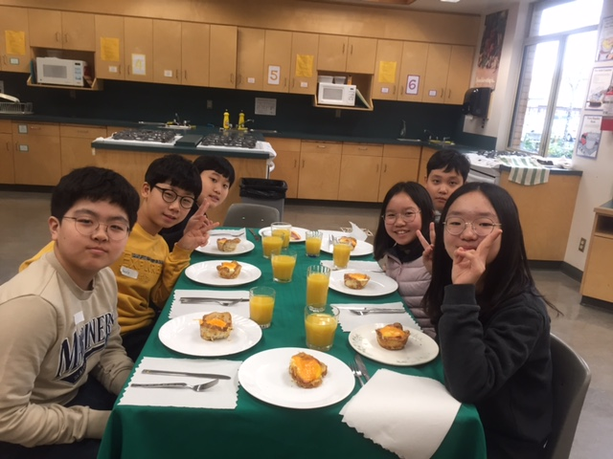
Building School Connections
ISP Advisor
QISP and School activities
Establish support for students to transition to post-secondary
Assist student in applying for Ministry of Education Scholarships
Short term elementary groups
Link and Connect classes
Global Partners/Marketing
To promote the Oceanside region as a destination of choice
Build a diverse recruiting strategy with overseas partners

Slide 8
Goal 3
Quality Programming
To provide optimal support and advocacy for ISP students and homestay families through best practices

Slide 9
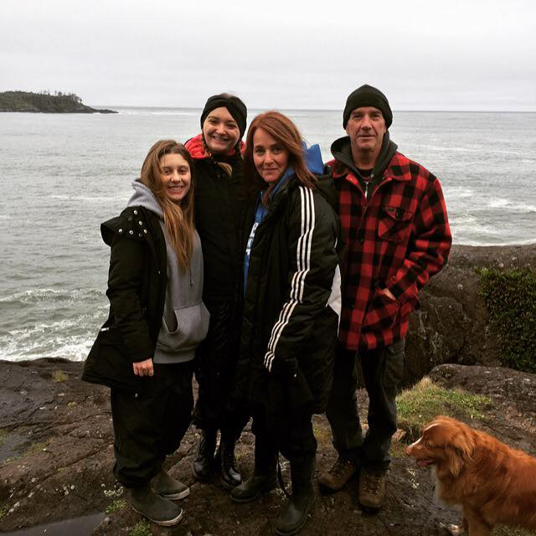
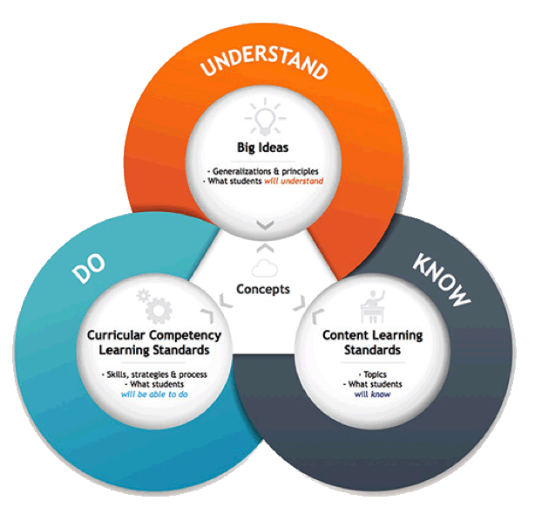
Ministry of Education
To align our program with the Ministry of Education K-12 International Strategic Action: 4 Pillars and Goals
Uphold Ministry of Education Homestay Standards
Homestay Families
Homestay guidebook
Homestay orientation
Informal homestay/student reporting
Homestay coordinators

Slide 10
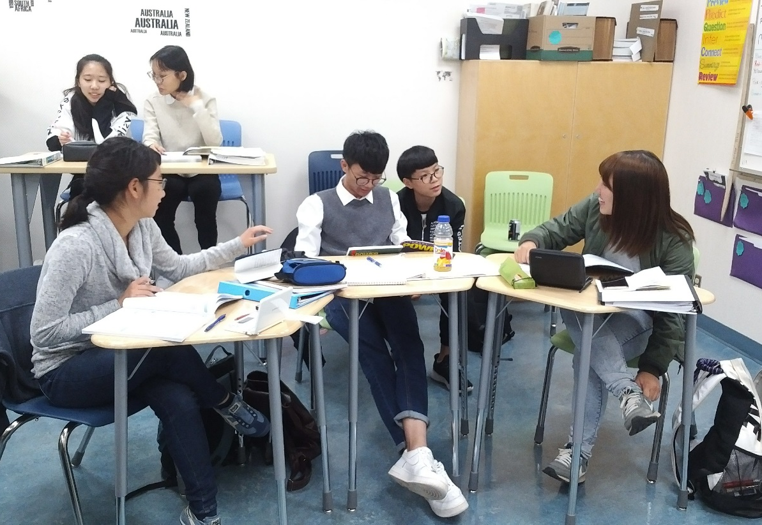
Students
Provide ELL professional development
Access to a Pre-arrival app
Student orientations
Provide comprehensive medical coverage
Review report cards and meet with students who require additional
support
After school tutorial
Flexible and responsive structures
New reporting procedures

Slide 11
Goal 4
Personal and Social Responsibility
To provide opportunities for students in areas of leadership, social responsibility and student led initiatives

Slide 12
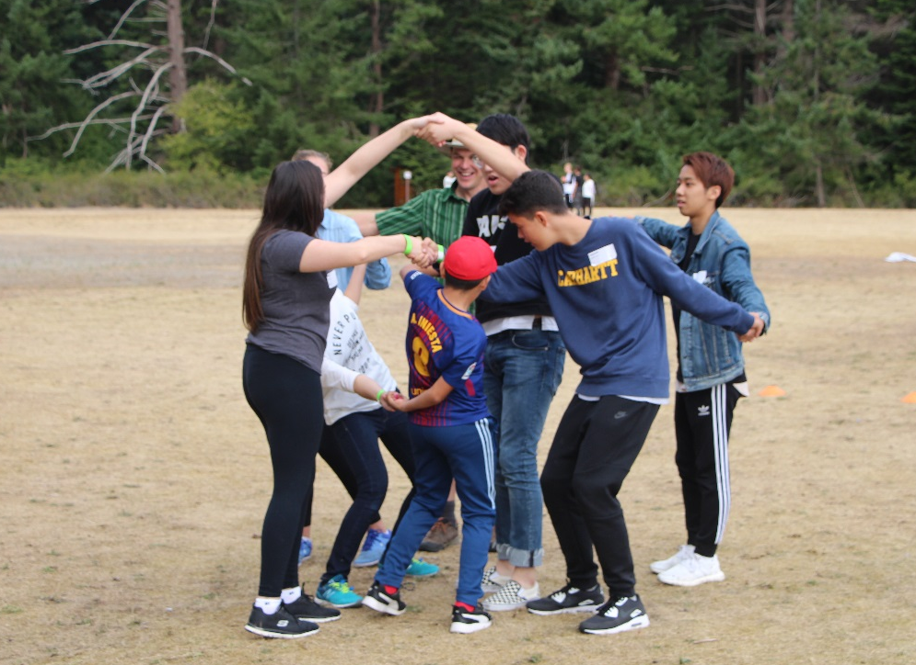
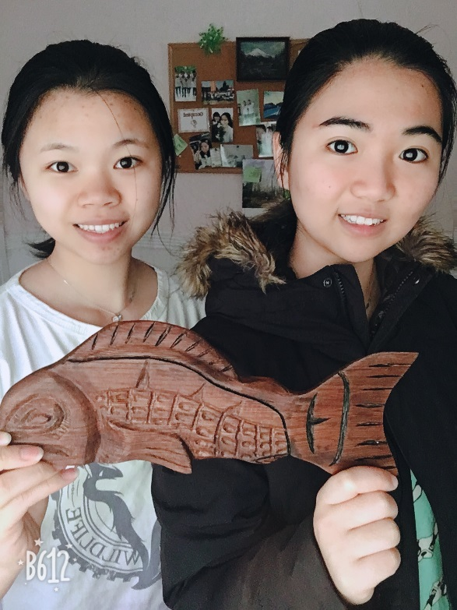
Building Connections – Aboriginal Understanding
English First People 10
Creation Story project
Button blanket
Cedar basket weaving
Dreamcatchers
Student Led Initiatives
Leading by example: - Peer teaching and leadership classes
Badminton club at Oceanside Elementary
Cultural day
Environmental Club

Slide 13
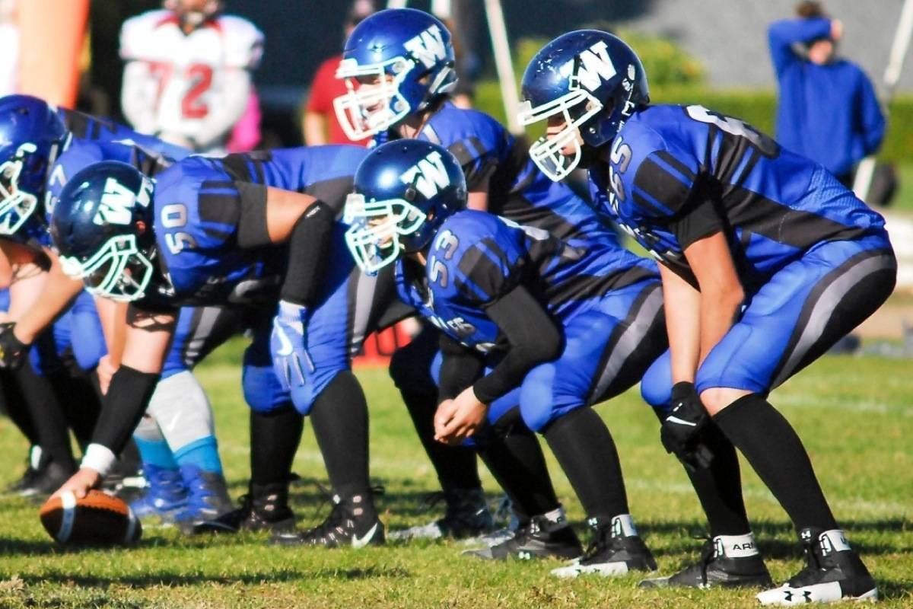
Personal and Social Responsibility
Developing awareness and working collaboratively to build a positive, safe and inclusive environment
Joining sport teams
Model UN
Open Gym nights
Anti bullying

Slide 14
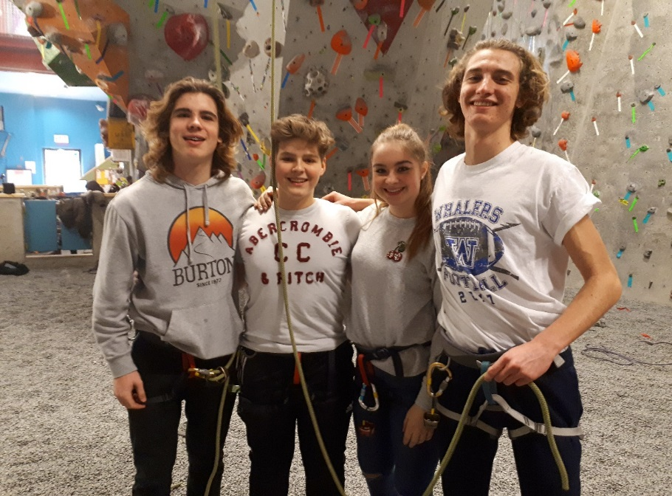
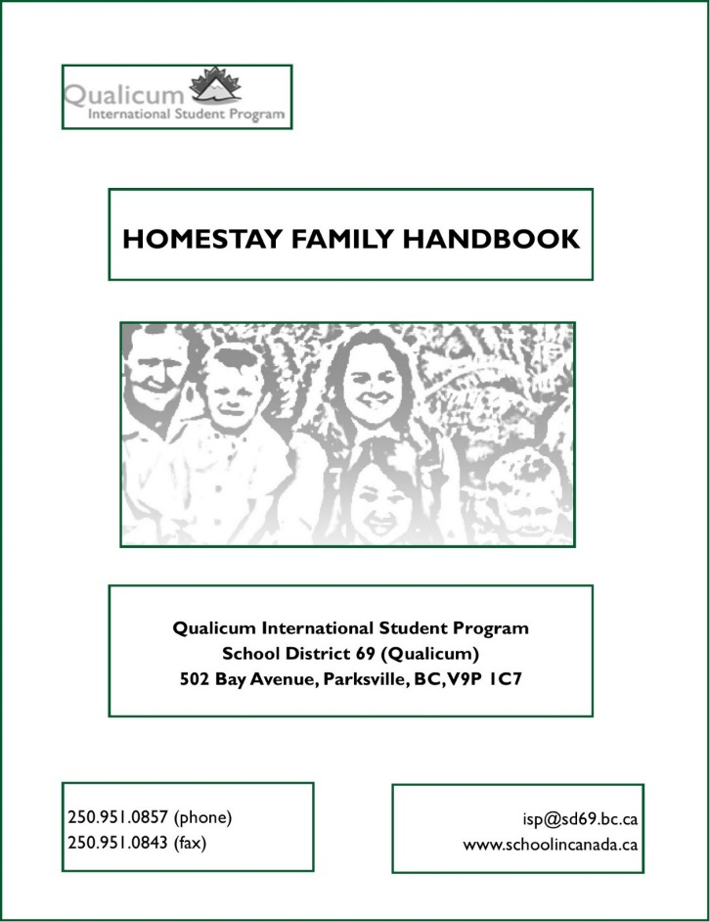
Highlights
First Cohort of Global Roams
Badminton Club at KSS
Homestay Handbook
Outbound Program to Japan
Created Tour-Guide Operator Position

Slide 15
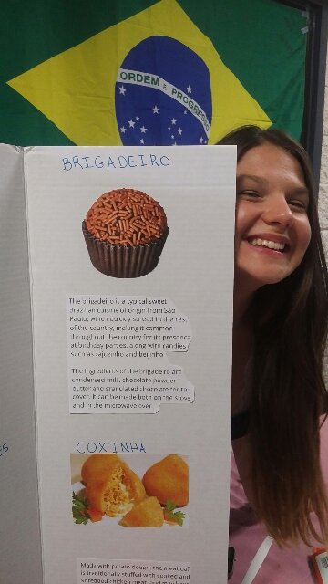
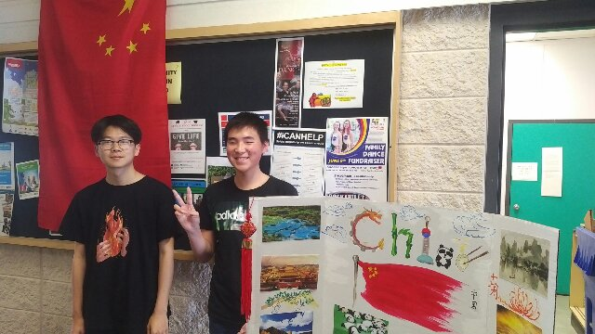
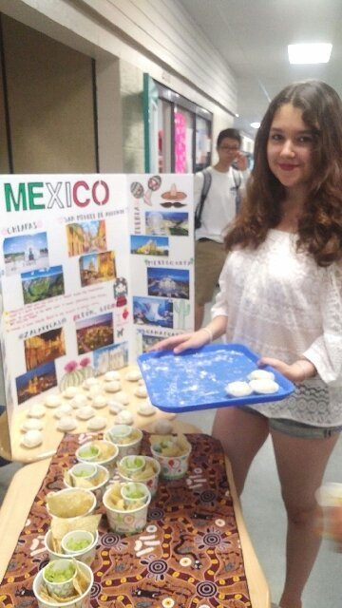
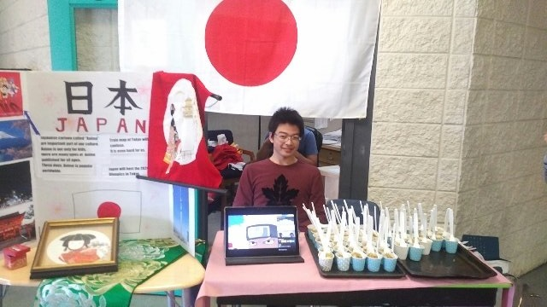
Cultural Day at Ballenas

Slide 16
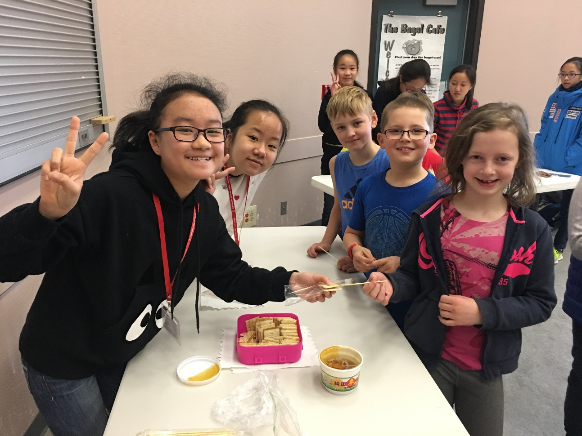
Short Term Programs
- Japan (Bunka Suginami)
- Mexico (Manterra)
- Hong Kong (Yuen Yuen)
- Japan (Aichi Keisei)
- Japan (Niijima)
- China (Sino-Ca)

