Slide 1

Qualicum School District
2025-26 Budget Information
Public Budget Session
February 12, 2025
2024-25 Amended Budget and September revisions
Background information: Financial/Enrolment/Staffing data
2025-26 Budget Planning Considerations
Next Steps

Slide 2
The Budget Process:

Slide 3

Annual Budget Cycle
January - March
Information gathering/Survey
Enrolment/staffing projections
Inclusion of Multi year planning
Partner/public info sessions
Grant announcement (mid March)
October - December
Staffing adjustments
Grant Recalculations
Amended Annual Budget adoption
(by Feb 28)
Budget
July – September
New School Year
School start up
Section/Classroom adjustments
April – June
Follow up with Partners/Public
Board/Management Discussions
Annual Budget adoption (by June 30)

Slide 4
Budget Planning
What makes a better budget | How we get there
Alignment with strategic plan and priorities | Provide Multi Year Financial Plan
Transparency, openness and accessibility | Hold Public meetings, publish documents and presentations
Participative, inclusive and realistic debate | Engage with all Partners
Comprehensive budget accounting | Alignment with Financial statement formats
Performance evaluation and value for money | Ongoing review of programs and priorities
Financial risks and sustainability | Understand what we know and what we don’t know (Enterprise Risk Management)
Quality, integrity and independent audit | Hire independent auditors for financial statements
Capital budgeting framework | Capital planning to understand needs, costs and funding mechanisms

Slide 5
2024-25 Amended Budget
September budget response due to enrolment and grant reduction
As the school year had begun and with limited options, our position was to minimize the disruption to classrooms and current programs.
Response was to impact
Supply budgets first and
Staffing second
With that in mind…

Slide 6
2024-25 Amended Budget
September budget response:
Hard responses (identified savings, to be implemented immediately) | Soft responses (unknown savings, to be managed throughout the year)
Internal capital funds were eliminated | Teacher/Support staff leaves would be monitored for replacement, i.e. medical
Supply funds were scaled back | Short term sick leave replacement would be rationalized
EA hours were held back | Bus Routes reviewed
Teachers were reassigned/reduced | Custodial workload reviewed
SBO staffing adjustments | Monitoring of Utilities-HV controls

Slide 7
2024-25 Amended Budget
Final Tallies for Amended budget balancing act:
Revenue side: | Expense side:
Operating grant reduction – ($485,000) | Exempt medical leaves ($140,000)
ISP revenues reduction – ($250,000) | Additional benefits burden not addressed with labour settlement funds ($45,000)
Investment revenues reduced – ($50,000) | Services for property disposition/labour relations ($75,000)
Only 1 layoff was required to address the revenue and expense pressures,
…..bulk of response came from District supported efforts

Slide 8
2025/26 Annual Budget
Planning Considerations:

Slide 9
2025-26 Budget Planning
On our radar
Multi Year Financial Planning continued priority of Ministry
Continue to align financial resources with our strategic plan, with links back to educational outcomes, i.e. supporting of educational programs through the goals of, “to Learn, to Give, to Grow, to Belong”
Communicate longer term allocations of our financial resources, to support future risks and future capital needs, i.e. recent facility decisions and focusing capital project requests to supported schools
Childcare and Food initiatives continue to be a priority
Provincial Budget and Economic trends
Bargaining begins and Funding priorities continue

Slide 10
25/26 Budget Planning – Ministry Themes
Childcare Programs
Currently 21 spaces operating in our Schools, including
5 Programs being run or supported by the School District
  Errington – Seamless Day Childcare and After School Program
  Oceanside – After School Program
  Bowser – After School Program
  Arrowview (run by OBLT) - Pre School and After School
Revenues generated from Parent fees, MECC grants and Sources funds
Seamless Daycare grant supported in past
New Spaces Funding – 2 Projects supported by not yet approve

Slide 11
Financial, Enrolment and Staffing data:

Slide 12
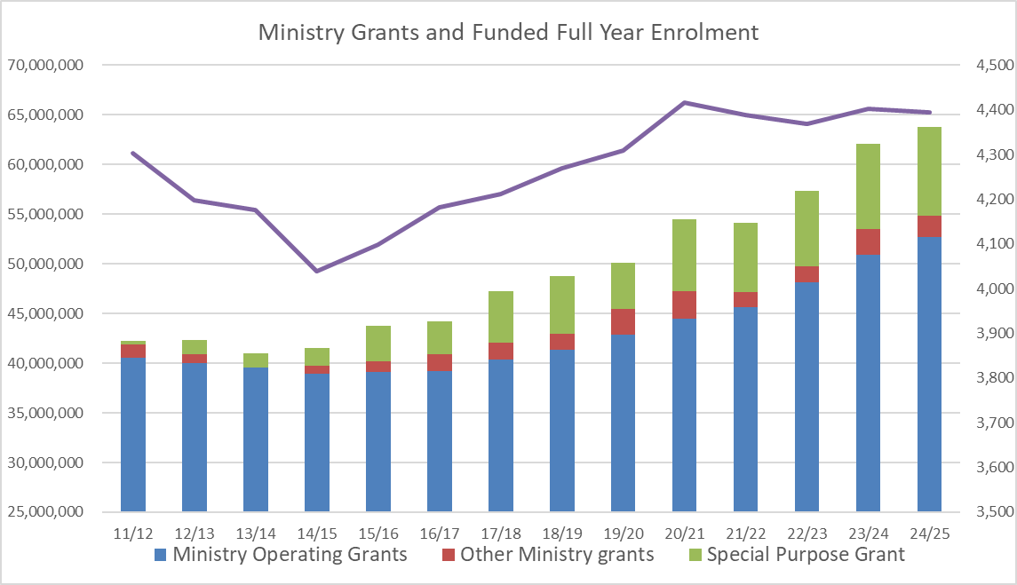
Grants and Enrolment:
- Modest growth since 2014 with first downturn in 24/25
- Ministry Grants have reflected this growth plus any bargained increases

Slide 13
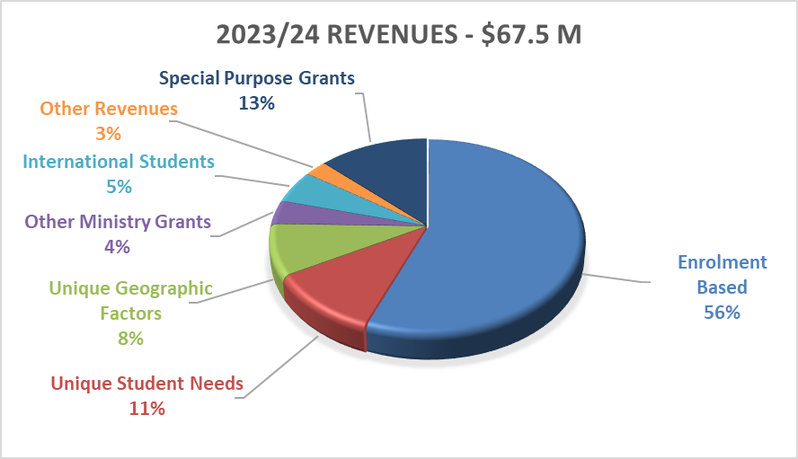
Where the revenues come from:
92% of Operating and Special Purpose Grants come from Ministry of Education and Childcare sources
From 2023/24 Audited Financial Statements

Slide 14
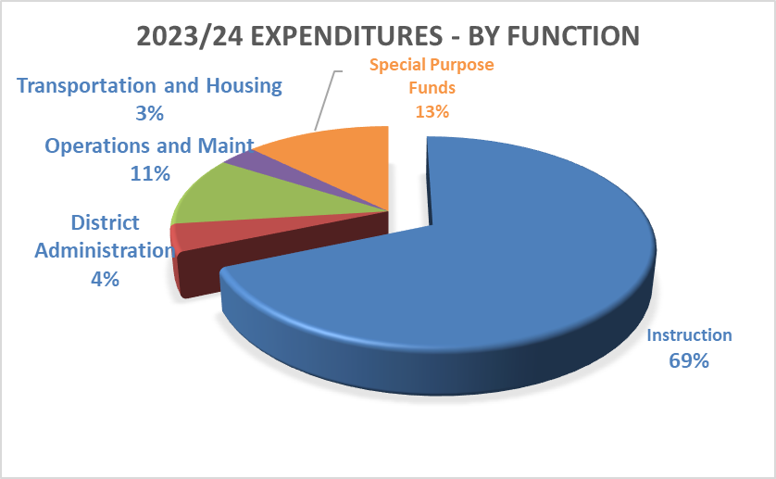
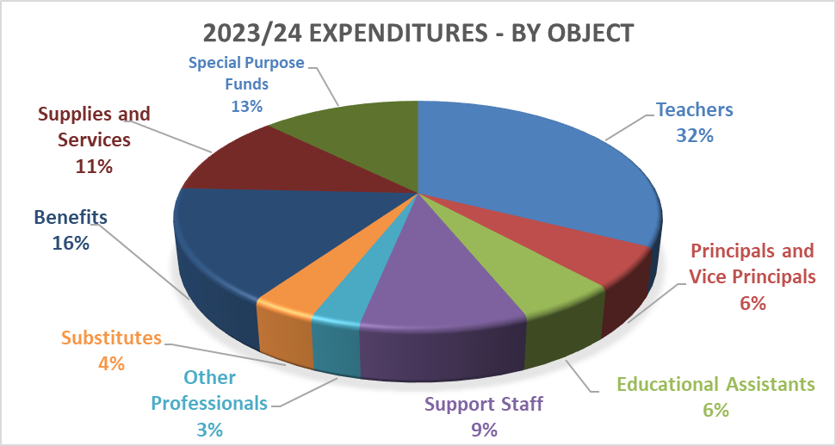
Where the funds are spent:
82% is spent on instructional programs such as regular instruction, counselling, library services, inclusive education, indigenous education, special purpose etc.
89% is spent on staffing costs (wages and benefits) with remaining 11% spent on supplies and services
From 2023/24 Audited Financial Statements

Slide 15
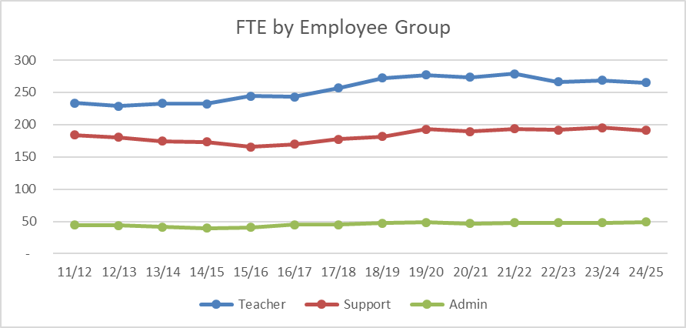
Staffing by Employee Group:
Staffing has generally followed the student enrolments trend with some exceptions due to priorities and new funding

Slide 16
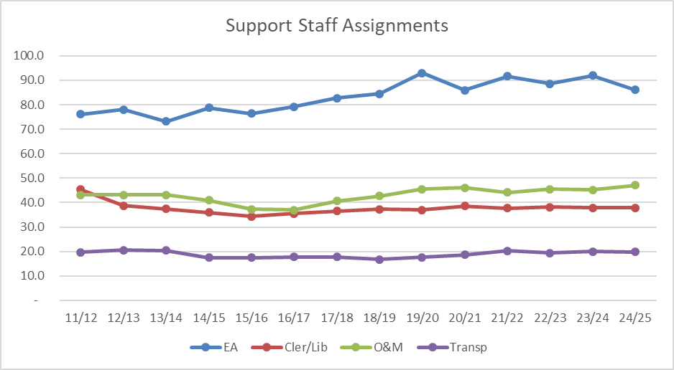
Staffing by Employee Group:
Staffing has generally followed the student enrolments trend with some exceptions due to priorities and new funding

Slide 17
2025/26 Annual Budget
Planning Considerations:

Slide 18
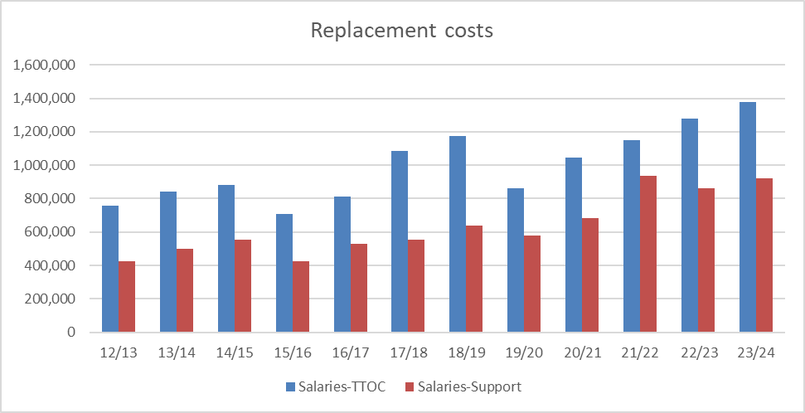
25/26 Planning – Cost pressures
Replacement costs continue to increase since the Pandemic; Cold, Flu, RSV & COVID continue to impact staff wellness

Slide 19
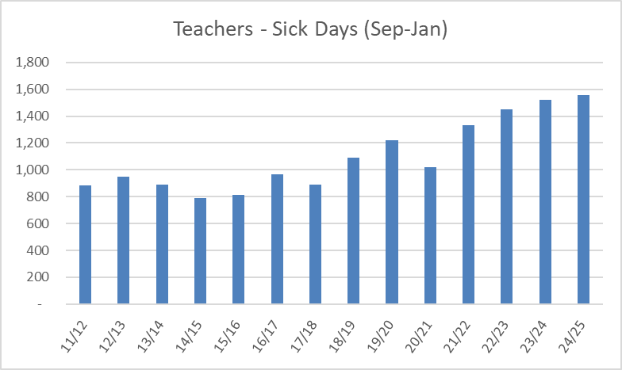
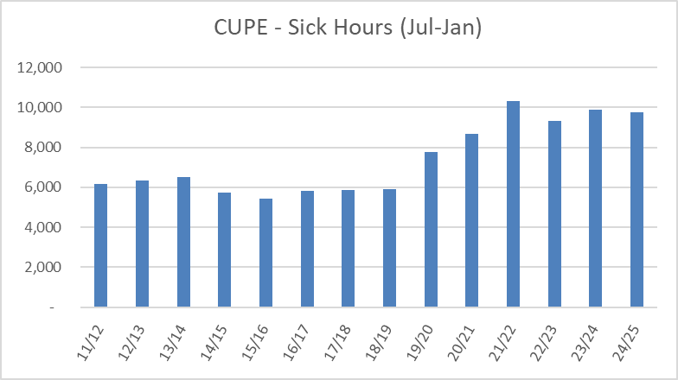
25/26 Planning – Cost pressures
Sick bank usage continues to increase but at slower rate

Slide 20
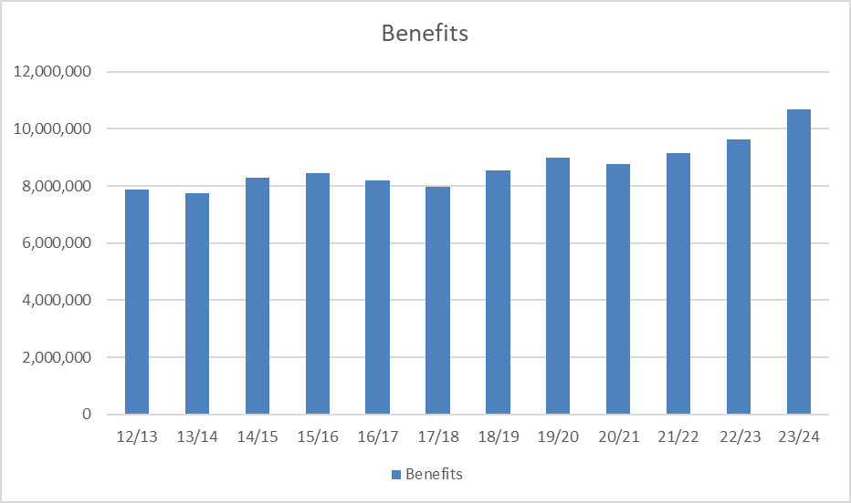
25/26 Planning – Cost pressures
Benefits costs are now pressuring budgets
- Some cost drivers are within our influence (WCB) but most are not (bargained increases in coverage)…

Slide 21
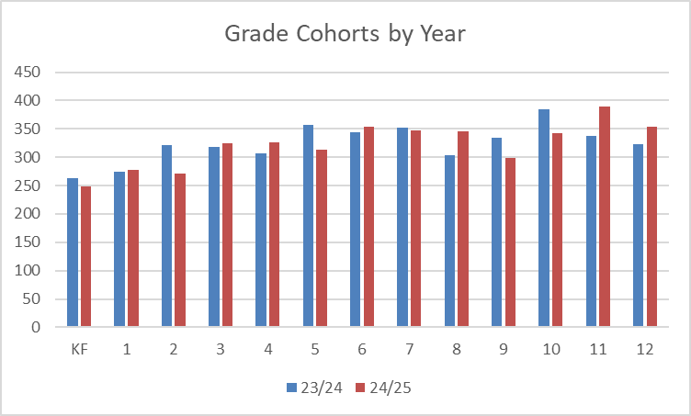
25/26 Planning – Understanding Projections
Projected student enrolment is based on:
the difference between the graduating 12’s and incoming K (12-K) and
any students moving into or out of the district (net of migration)

Slide 22
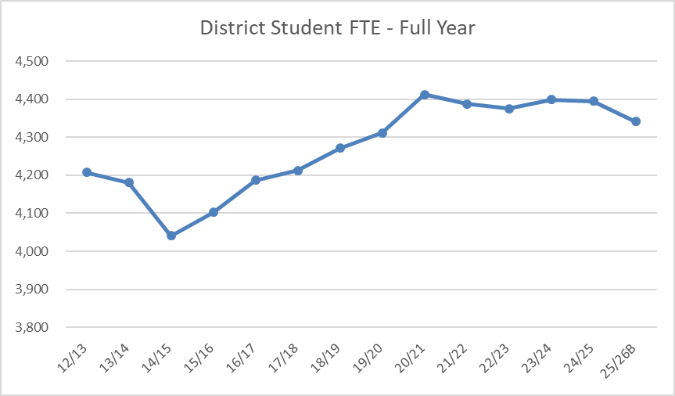
25/26 Planning – Enrolment
Projected enrolment is still to be determined but is anticipated to be down for next school year – conservative estimate (60.0 FTE)
Full Year included September, February and May student counts

Slide 23
25/26 Budget Planning - Recap
Enrolment projections and staffing needs will be based on a decline in enrolment
Other needs to consider
  Cost pressures - replacement and benefit costs, supply budgets
  Re-establish Local Capital initiatives - IT infrastructure and White fleet
  Closing of buildings - LT savings, but has ST revenue loss
  Budget survey for Public feedback will go live next week

Slide 24

Next steps
February - Conversations with Board/Partner/Public
March 14 - Ministry Funding Announcement
April/May - Budget meetings with Partner Representatives
May 20 - Special Public Board meeting on Budget
May 27 - Regular Board meeting motion to approve 25/26 Annual Budget
By June 30 - Annual Budget must be approved and submitted to Ministry

Slide 25
Thank you!

Slide 26
25/26 Survey Questions:
5 areas of inquiry
  Student Learning
  Learning Resources
  Facilities and Transportation
  Parent and Community Partnerships
  Truth and Reconciliation
What do you feel is going well related to…
What concerns to consider related to…
Is there anything else you would like the Board to consider related to the budget?

Slide 27
2025-26 Budget Planning
On our radar from ministry communications:
Mandate letter for Hon. Lisa Beare, Minister, MECC
Review all existing MECC programs and initiatives to ensure programs remain relevant are efficient and improve the experience of those who access child care and education services in BC
Expansion of EAs and Counseling resources
Accelerate delivery of new and expanded schools, improve access to affordable child care
Work to increase Indigenous Grad rates
Messaging from Kaye Krishna DM, MECC,
In sharing her thoughts on a possible challenging year ahead, asking Districts to “…operate with good judgement and be thoughtful and prudent in your Budget discussions and decisions…”

