Slide 1
Qualicum School District
24/25 Budget Information
Public/Stakeholders Session
February 15, 2024
The Budget Process
Historical information: Financial and Enrolment data
Budget planning considerations
Ministry Priorities
Capital Planning considerations
Survey results
Next Steps

Slide 2
The Budget Process:

Slide 3
Annual Budget Cycle
January - March
Information gathering/Survey
Enrolment/staffing projections
Inclusion of Multi year planning*
Partner/public info sessions
Grant announcement (mid March)
October - December
Staffing adjustments
Grant Recalculations
Amended Annual Budget adoption
(by Feb 28)
Budget
July – September
New School Year
School start up
Section/Classroom adjustments
April – June
Follow up with Partners/Public
Board/Management Discussions
Annual Budget adoption (by June 30)

Slide 4
2024-25 Budget Planning
What makes a better budget?
What | How
Alignment with strategic plan and priorities | Multi Year Financial Plan
Transparency, openness and accessibility | Public meetings, documents and presentations
Participative, inclusive and realistic debate | Engagement of all Stakeholders
Comprehensive budget accounting | Aligns with Financial statement formats
Performance evaluation and value for money | Review of programs and priorities
Fiscal risks and sustainability | What we know, what we don’t know
Quality, integrity and independent audit | Independent audit of financial statements
Capital budgeting framework | Understanding costs and funding mechanisms

Slide 5
2024-25 Budget Planning
On our radar
Multi Year Financial Planning continued priority of Ministry
Aligning financial resources with our strategic plan and operational needs, with links back to educational outcomes
Communicates allocations of our financial resources over several years, to support future risks and longer term capital planning
Childcare and Food initiatives continue to be a priority
Fall Elections?
Impact on Bargaining and Funding priorities

Slide 6
Financial and Enrolment Data (historical):

Slide 7
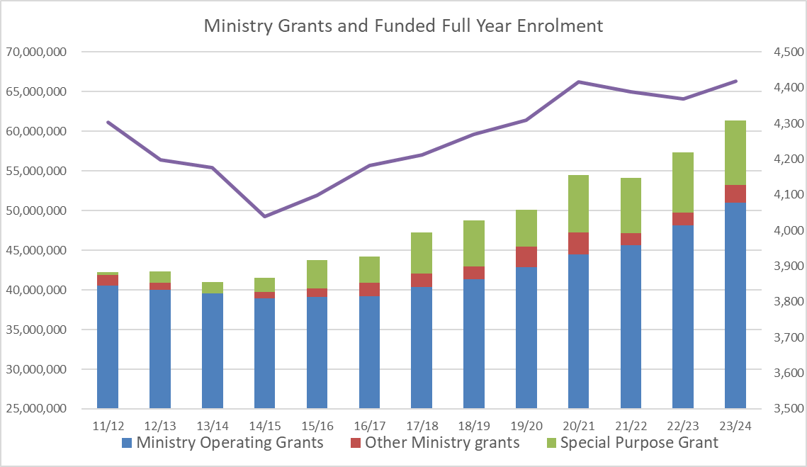
Grants and Enrolment:
- Modest growth since 2014 (9.4% since 14/15 or 1% per year)
- Ministry Grants have reflected this growth plus any bargained increases

Slide 8
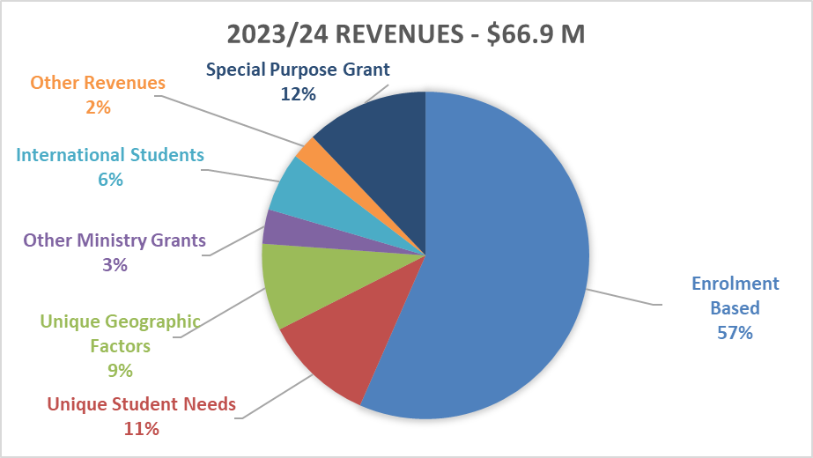
Operating Revenues:
92% of Operating and Special Purpose Grants come from the Ministry of Education with 8% coming from other sources

Slide 9
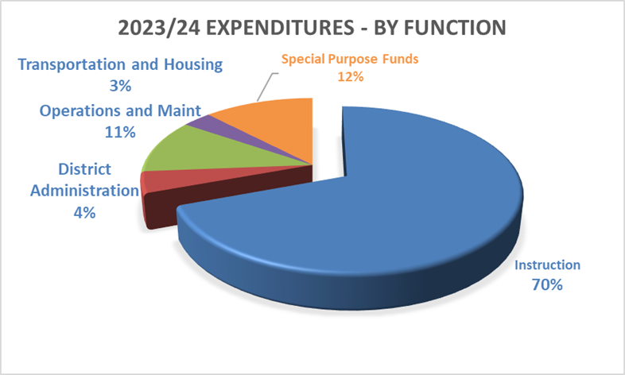
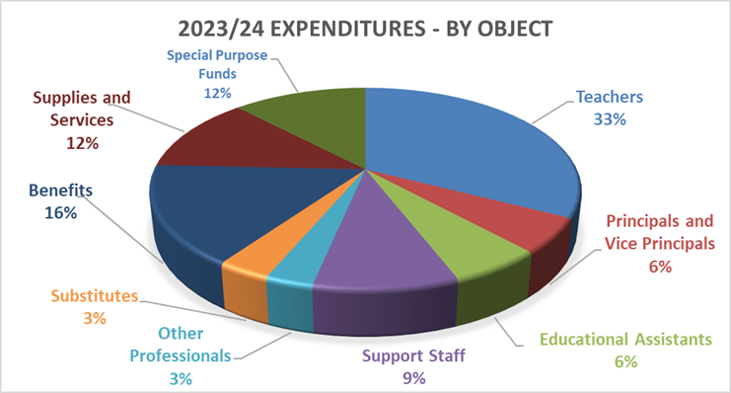
Operating Expenditures:
88% of the Budget is spent on wages and benefits, the remaining 12% spent on Supplies and Services
82% of the Budget is spent on Classroom Instruction and other Educational programs with 18% spent on Transportation, Facility Maintenance and Administration

Slide 10
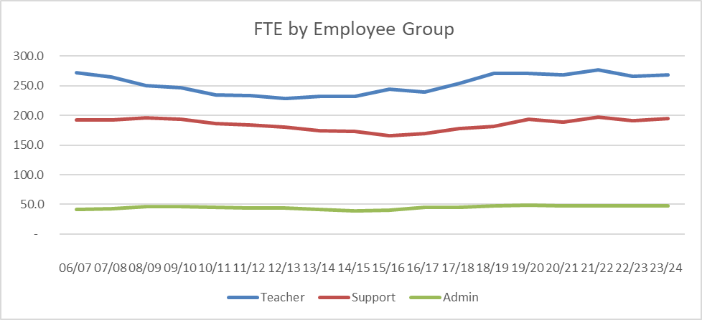
Staffing by Employee Group:
Staffing has generally followed the student enrolments trend with some exceptions due to priorities and new funding

Slide 11
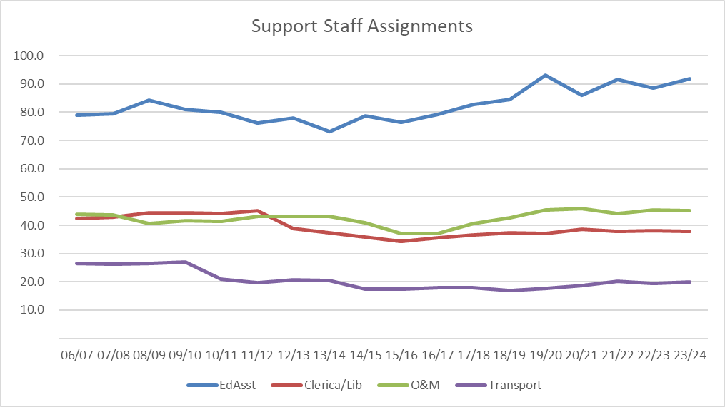
Staffing by Employee Group:
Staffing has generally followed the student enrolments trend with some exceptions due to priorities and new funding

Slide 12
Budget Planning Considerations:

Slide 13
2024-25 Budget Planning
Budget Risks
New Collective Agreement (Year 3 of 3)
Labour Settlement funding for Teachers, Support staff and Exempt
Last year of Bargained wage increases for Teachers and Support staff, 2% plus up to 1% for COLA
Will Exempt staff increases be funded
Cost pressures
Supplies, benefits and replacement costs
Increased use of Special Purpose Funds for Ministry initiatives
Shifts funding from local priorities to Provincial priorities, e.g. Feeding Futures

Slide 14
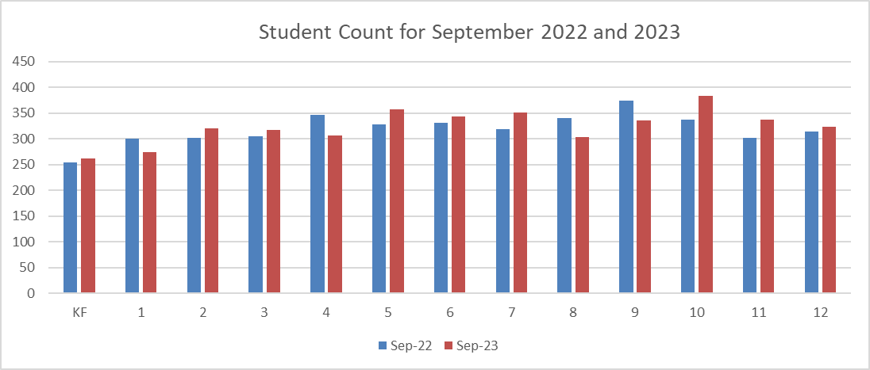
24/25 Planning – Enrolment by Program
Difference in Graduating 12’s and incoming K’s is now about 73 (323 – 250) need a net migration of 73 to fall even… last year net migration was 51

Slide 15
24/25 Planning – Understanding Projections
Projections try to predict the migration and program patterns

Slide 16
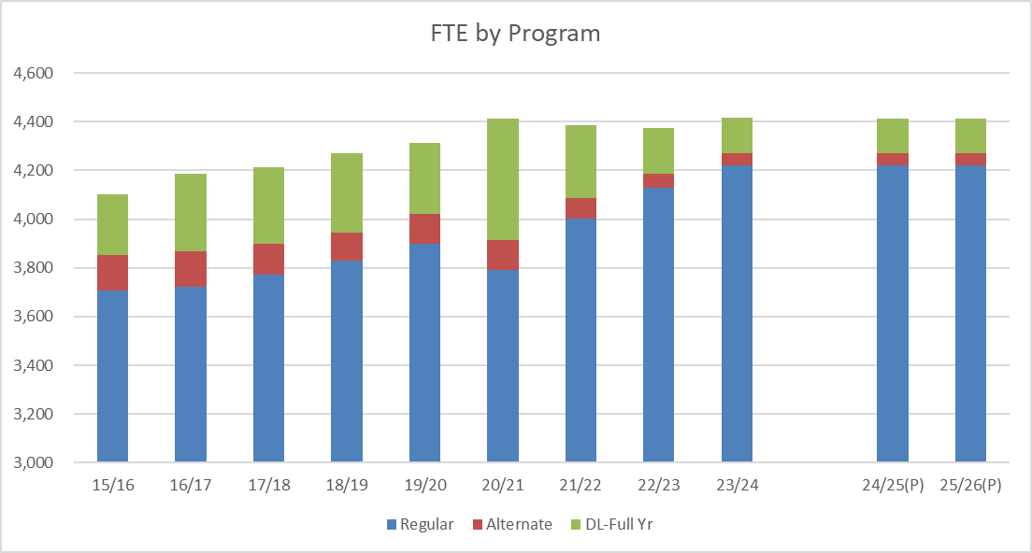
24/25 Planning – Enrolment by Program
Program demands have changed since the Pandemic, resulting in budget pressures…

Slide 17
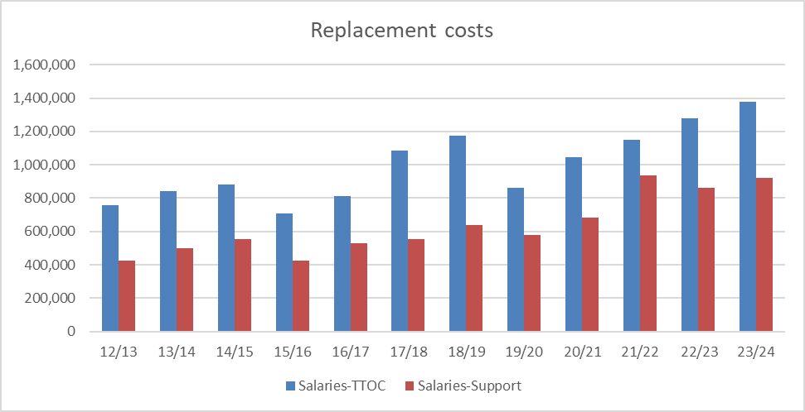
Replacement costs continue to increase since the Pandemic; Cold, Flu, RSV & COVID continue to impact staff wellness
Our experience is also unique as we are able to fill most/all vacancies
24/25 Planning – Cost pressures

Slide 18
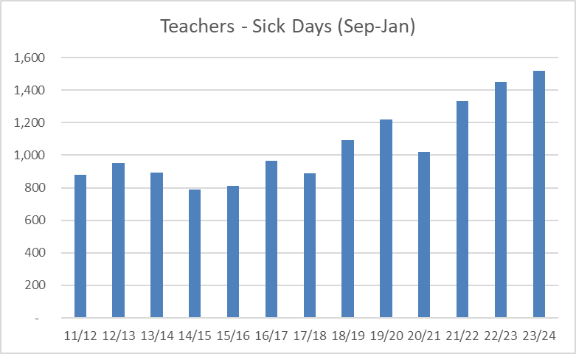
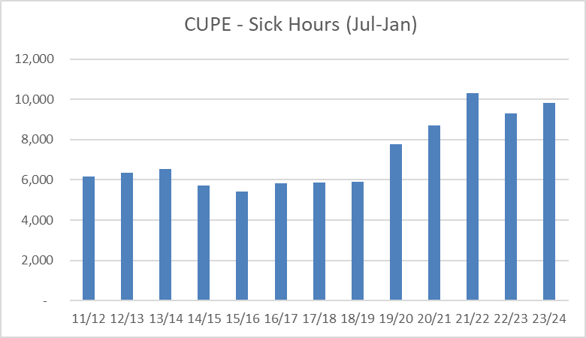
24/25 Planning – Cost pressures
Reviewing the Year over Year comparisons, we are seeing the trend continue in the current year

Slide 19
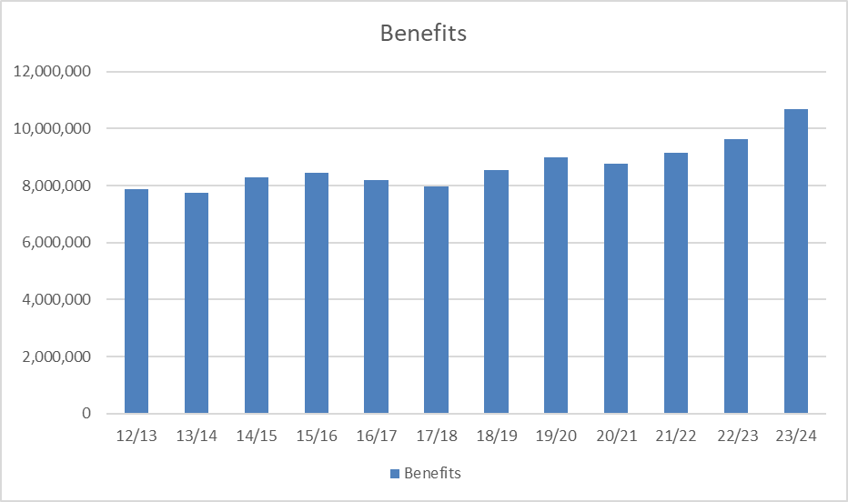
24/25 Planning – Cost pressures
Benefits costs are now pressuring budgets
- Some cost drivers are within our influence (WCB) but most are not (bargained increases in coverage)…

Slide 20
Ministry Priorities:

Slide 21
24/25 Budget Planning – Ministry Themes
Childcare Programs
Currently 21 spaces operating in our Schools, including
5 Programs being run or supported by the School District
Errington – Seamless Day Childcare and After School Program
Oceanside – After School Program
Bowser – After School Program
Arrowview (run by OBLT) - Pre School and After School
Revenues generated from Parent fees, MECC grants and Sources funds
Seamless Daycare grant supported for 1 last year
New Spaces Funding – Streamlined application process

Slide 22
24/25 Budget Planning – Ministry Themes
Early Care and Learning Grant (ECL)
Funding is committed for 3rd year, $175,000
Supports the Early Learning work of Principal, Sheila Morrison

Slide 23
24/25 Budget Planning – Ministry Themes
Feeding Futures Fund
Next year will be Year 2 of 3 year commitment
$519,738 for supplies and staffing
Program being delivered in concert with Backpack program
Food Infrastructure program (FIP)
23/24 - $102,830 for kitchen renovations at KSS and Winchelsea
24/25 - $100,419 for additional equipment

Slide 24
Capital Planning considerations:

Slide 25
24/25 Budget Planning – Capital Considerations
Revenues generally cover direct operating costs only,
not indirect or capital costs,
eg. administrative/grounds/trades

Slide 26
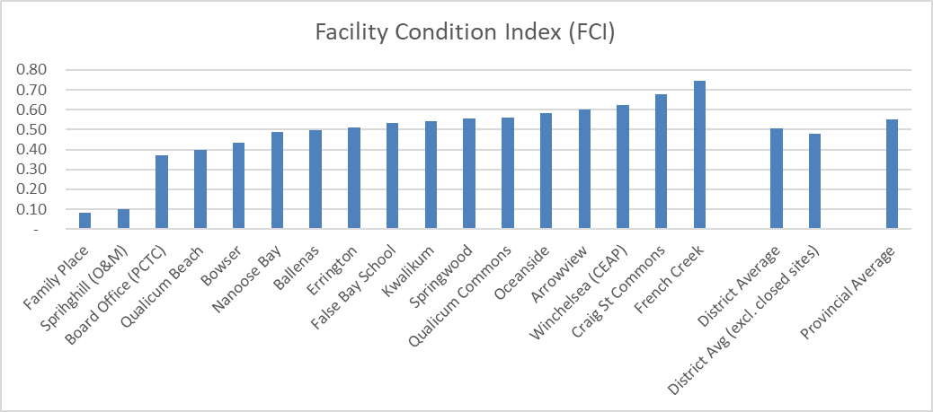
24/25 Budget Planning – Capital Considerations

Slide 27
24/25 Budget Planning - Recap
Amended budget did not need surplus to balance and 23/24 funding allowed us to put aside some contingency
Enrolment projections will be based on no growth
Need to consider
Cost pressures - replacement and benefit costs
Funding for bargained wage increases still needs to be understood
Local capital initiatives will continue, IT infrastructure and White Fleet

Slide 28
24/25 Survey Questions:
5 areas of inquiry
Student Learning
Learning Resources
Facilities and Transportation
Parent and Community Partnerships
Truth and Reconciliation
What do you feel is going well related to…
What concerns to consider related to…
Is there anything else you would like the Board to consider related to the budget?
96 Responses: 40 parents/37 Teachers/13 Support staff

Slide 29
24/25 Budget Planning – Early Survey results
Quality Teachers | Appreciation for dedicated teachers and support staff.
Leadership Appreciation | Recognition of effective school leadership.
Indigenous Resources | Calls for more resources and support for Indigenous education.
Student Engagement | More emphasis on engaging students and adapting teaching methods to diverse learning styles.
Food Programs and Support | Recognition of programs addressing food insecurity and mental health support.
Technology Integration | Acknowledgment of sufficient technological resources.
Literacy Focus | Suggestions for a greater focus on literacy.
Individualized Support | Recognition of efforts to meet individual student needs.
Challenges | Concerns about behavioral issues and academic performance.
Social-Emotional Learning | Emphasis on emotional well-being and learning through play.
Parent and Community Support | Gratitude for community support and inclusive policies, particularly for LGBTQ2+ students.
Safe Environment | Importance of creating a safe and positive learning environment.
Facilities and Maintenance | Efforts to consolidate old non-school sites and respond to work orders

Slide 30
Next steps
February - Conversations with Board/Stakeholders/Public
March 15 - Ministry Funding Announcement
April 9 - Budget meeting with Stakeholder Representatives
April 16 - Special Public Board meeting on Budget
April 23 - Regular Board meeting motion to approve 24/25 Annual Budget
By June 30 - Annual Budget must be approved and submitted to Ministry

