Slide 1
Qualicum School District
24/25 Budget Information
Special Budget Board meeting
April 16, 2024
Budget Process to date
Budget survey results
Operating Grant announcement
Cost pressures
Budget response considerations
Next Steps

Slide 2
Budget Process to date:

Slide 3
Annual Budget Cycle
January - March
Information gathering/Survey
Enrolment/staffing projections
Inclusion of Multi year planning*
Partner/public info sessions
Grant announcement (mid March)
October - December
Staffing adjustments
Grant Recalculations
Amended Annual Budget adoption
(by Feb 28)
Budget
July – September
New School Year
School start up
Section/Classroom adjustments
April – June
Follow up with Partners/Public
Board/Management Discussions
Annual Budget adoption (by June 30)

Slide 4
2024-25 Budget Planning
What makes a better budget?
What | How
Alignment with strategic plan and priorities | Multi Year Financial Plan
Transparency, openness and accessibility | Public meetings, documents and presentations
Participative, inclusive and realistic debate | Engagement of all Stakeholders
Comprehensive budget accounting | Aligns with Financial statement formats
Performance evaluation and value for money | Review of programs and priorities
Fiscal risks and sustainability | What we know, what we don’t know
Quality, integrity and independent audit | Independent audit of financial statements
Capital budgeting framework | Understanding costs and funding mechanisms

Slide 5
Budget Survey results:

Slide 6
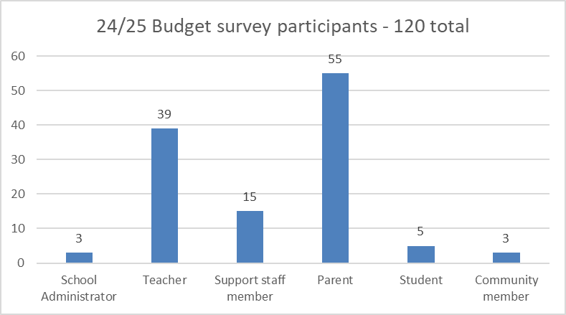
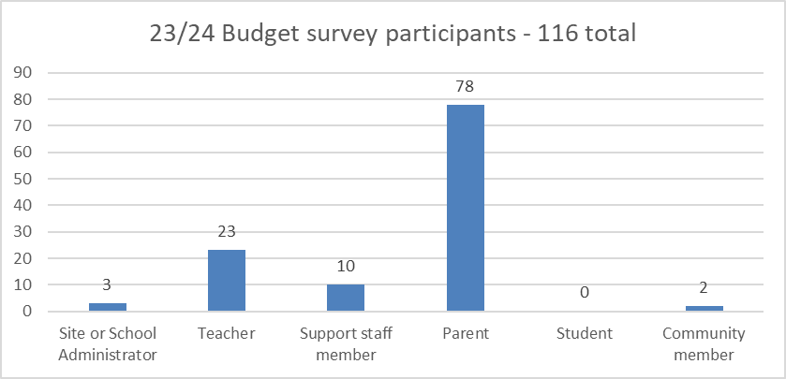
24/25 Budget Planning – Survey results

Slide 7
24/25 Budget Planning – Survey results
Quality Teachers | Appreciation for dedicated teachers and support staff.
Leadership Appreciation | Recognition of effective school leadership.
Indigenous Resources | Calls for more resources and support for Indigenous education.
Student Engagement | More emphasis on engaging students and adapting teaching methods to diverse learning styles.
Food Programs and Support | Recognition of programs addressing food insecurity and mental health support.
Technology Integration | Acknowledgment of sufficient technological resources.
Literacy Focus | Suggestions for a greater focus on literacy.
Individualized Support | Recognition of efforts to meet individual student needs.
Challenges | Concerns about behavioral issues and academic performance.
Social-Emotional Learning | Emphasis on emotional well-being and learning through play.
Parent and Community Support | Gratitude for community support and inclusive policies, particularly for LGBTQ2+ students.
Safe Environment | Importance of creating a safe and positive learning environment.
Facilities and Maintenance | Efforts to consolidate old non-school sites and respond to work orders

Slide 8
Operating Grant announcement:

Slide 9
2024-25 Budget Planning
Operating Grant Announcement
Provincial Education funding increased by $344 million
Committed to Fully fund wage increases for all staff based on Provincial Bargaining
Some additions to Classroom Enhancement fund and Community Link funds based on staff allocations
Limited increases for replacement cost pressures or other inflationary factors
Early Care and Learning, Family affordability and Food initiatives continue to be a priority
Some commitments are still to be confirmed – Learning supports and additional Food funds

Slide 10
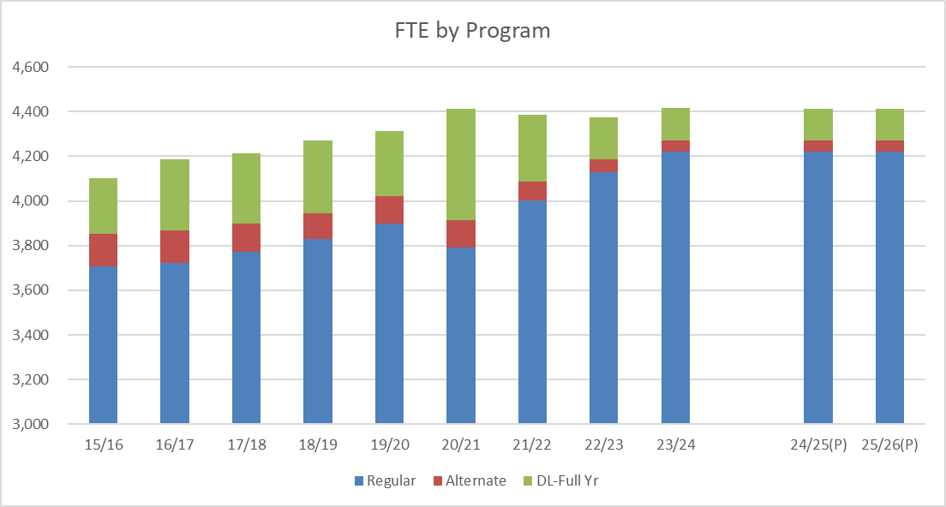
24/25 Planning – Enrolment by Program
Reminder: Enrolment for September is expected to be the same as this year,
i.e. no new funding for enrolment growth…

Slide 11
2024-25 Budget Planning
24-25 Operating grant
 |  | Totals |  | Notes
23/24 Operating Grant (Recalculated) |  | 50,967,384
23/24 Labour Settlement special grant |  | 880,998 |  | rolled into grant for 24/25
Total 23/24 Operating grants |  | 51,848,382
Estimated 24/25 Operating grant |  | 53,217,746 |  | includes 2% for Teachers/Support staff/Non educator exempt
Increase in Operating grant |  | 1,369,364 |  | before escalations and requests
Additional funds (approx. $450,000) are coming from Unique Geographic supplemental funding: student location factor/small school supplements

Slide 12
2024-25 Budget Planning
 |  | Total |  | Notes
Increase in Operating grant |  | 1,369,364 |  | before escalations and requests
Estimated wage costs for 2% plus statutory benefits |  | 950,000 |  | remaining 1% distributed as Special grant
Estimated additional benefits |  | 470,000 | * | escalating costs for WCB/EHB/Dental
Estimated replacement cost increase |  | 100,000 | * | escalating costs for Subs/TTOC
Insurance increases |  | 35,000
Recruitment/Legal fees |  | 50,000
Increase in committed costs |  | 1,605,000
Funding surplus (shortfall) |  | (235,636)
Additional requests | FTE
NRT/Teacher staffing | 2.50 | 262,500 |  | requested to support NRT work and classroom pressures
Shortfall after all escalations and requests |  | (498,136) | **
* More discussion on these pressures in the next section

Slide 13
Cost pressures:

Slide 14
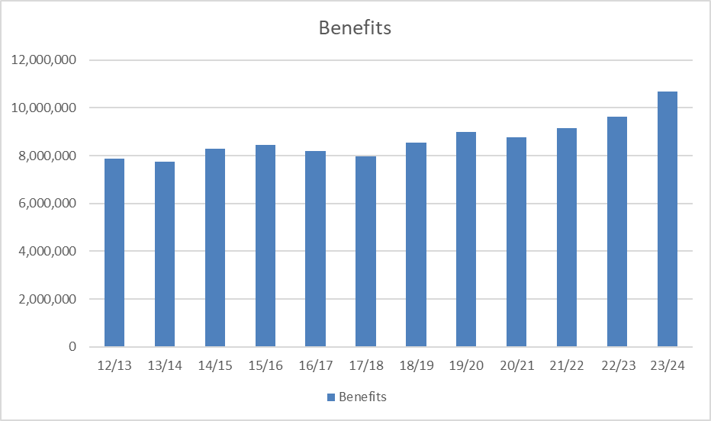
24/25 Planning – Cost pressures
Benefits costs are now pressuring budgets
- Some cost drivers are within our influence (WCB) but most are not (bargained increases in coverage)…
Est. 24/25 27.7%

Slide 15
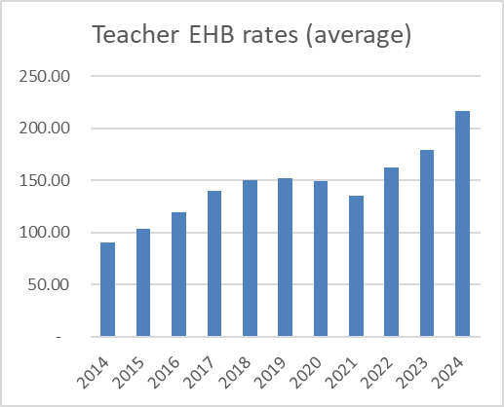
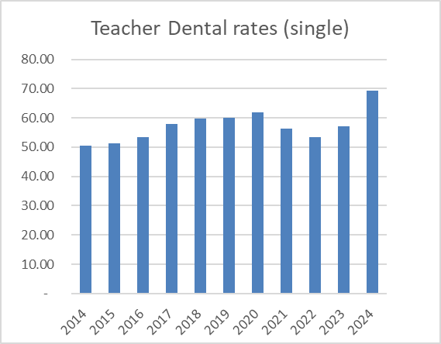
24/25 Planning – Cost pressures
Teacher rates are just examples as all employee groups are increasing proportionately

Slide 16
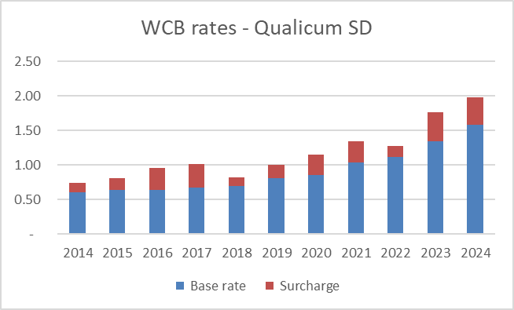
24/25 Planning – Cost pressures
Base rate is based on the classification unit assigned to us by WorkSafe BC: Public School District
 | How we as a sector are doing
Surcharge is calculated from our experience and adjusts our rate +/-
 | How we are doing versus the sector

Slide 17
24/25 Planning – Cost pressures
Pension contribution rates remain unchanged

Slide 18
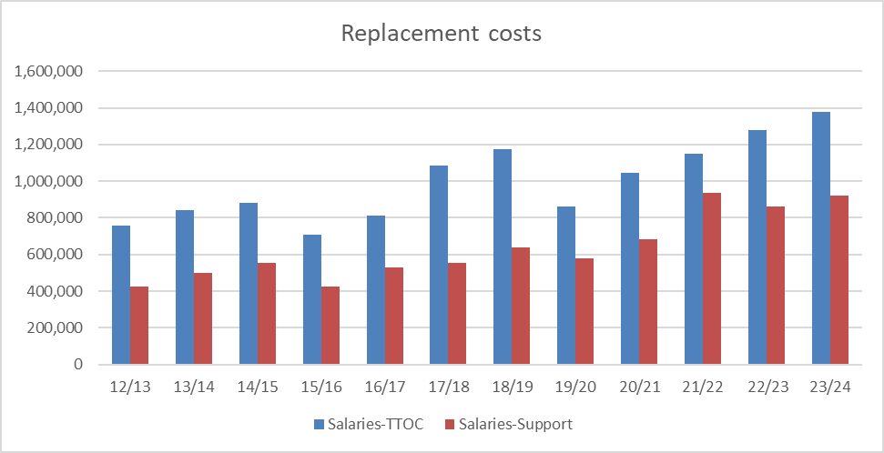
Replacement costs continue to increase since the Pandemic; Cold, Flu, RSV & COVID continue to impact staff wellness
Our experience is also unique as we are able to fill most/all vacancies
24/25 Planning – Cost pressures

Slide 19
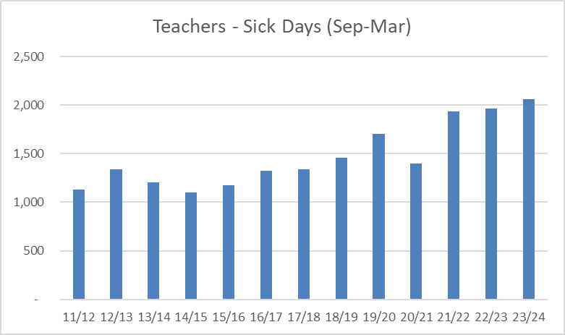
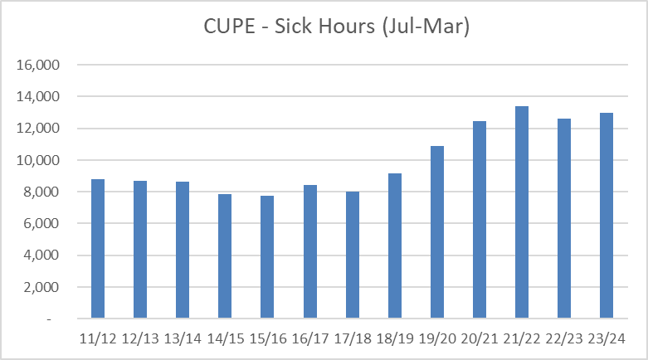
24/25 Planning – Cost pressures
Reviewing the Year over Year comparisons, we are seeing the trend continue in the current year

Slide 20
Budget response considerations:

Slide 21
2024-25 Budget Planning - Recap
 |  | Total |  | Notes
Increase in Operating grant |  | 1,369,364 |  | before escalations and requests
Estimated wage costs for 2% plus statutory benefits |  | 950,000 |  | remaining 1% distributed as Special grant
Estimated additional benefits |  | 470,000 | * | escalating costs for WCB/EHB/Dental
Estimated replacement cost increase |  | 100,000 | * | escalating costs for Subs/TTOC
Insurance increases |  | 35,000
Recruitment/Legal fees |  | 50,000
Increase in committed costs |  | 1,605,000
Funding surplus (shortfall) |  | (235,636)
Additional requests | FTE
NRT/Teacher staffing | 2.50 | 262,500 |  | requested to support NRT work and classroom pressures
Shortfall after all escalations and requests |  | (498,136) | **

Slide 22
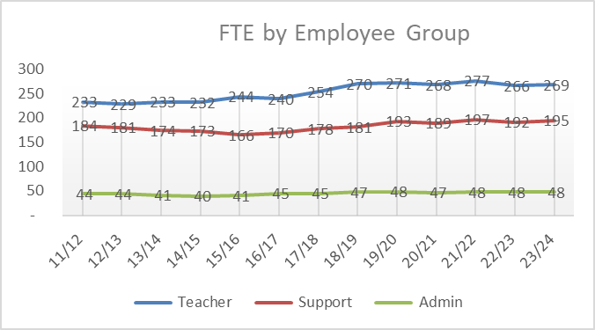
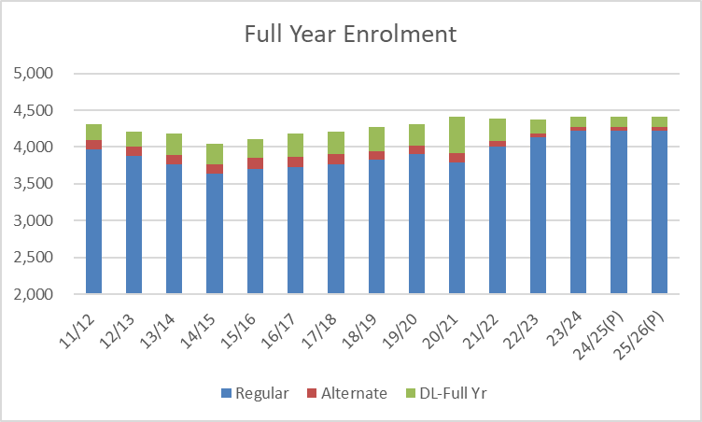
24/25 Budget Planning - Response

Slide 23
24/25 Budget Planning – Capital Needs
Other planning considerations (funded from Ministry or Local support)
Local capital – IT equipment and White Fleet replacement
Ministry minor projects – Washroom improvements/roofing/electrical
Ministry major projects – False Bay Seismic mitigation/replacement
Community supported capital projects – BSS Track upgrade
Capital needs at rented Facilities ($4-5 million, not funded)
– Qualicum Commons and Craig Street Commons

Slide 24
Next steps
April 16 - Special Public Board meeting on Budget (tonights meeting)
April 23 - Regular Board meeting motion to approve 24/25 Annual Budget
By June 30 - Annual Budget must be approved and submitted to Ministry

