Slide 1
Qualicum School District Career Education

Slide 2
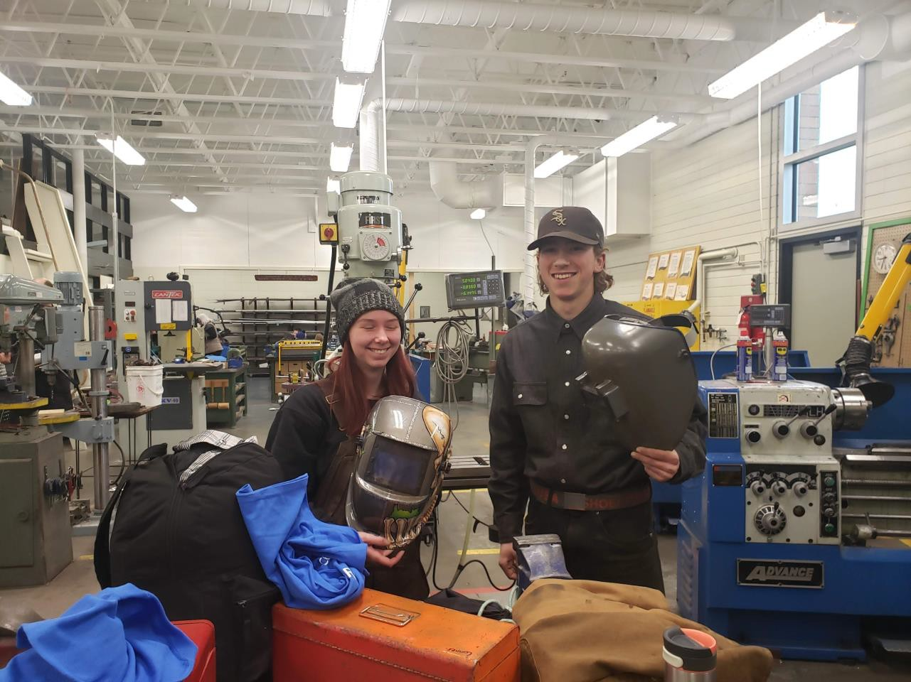
Work Experience
Opportunity for students in grades 10+ to use their job or volunteer roles to earn credits towards graduation
Currently have 270 students enrolled in the program between Ballenas, Kwalikum and CEAP
Has the possibility to ladder into an apprenticeship for some students.

Slide 3
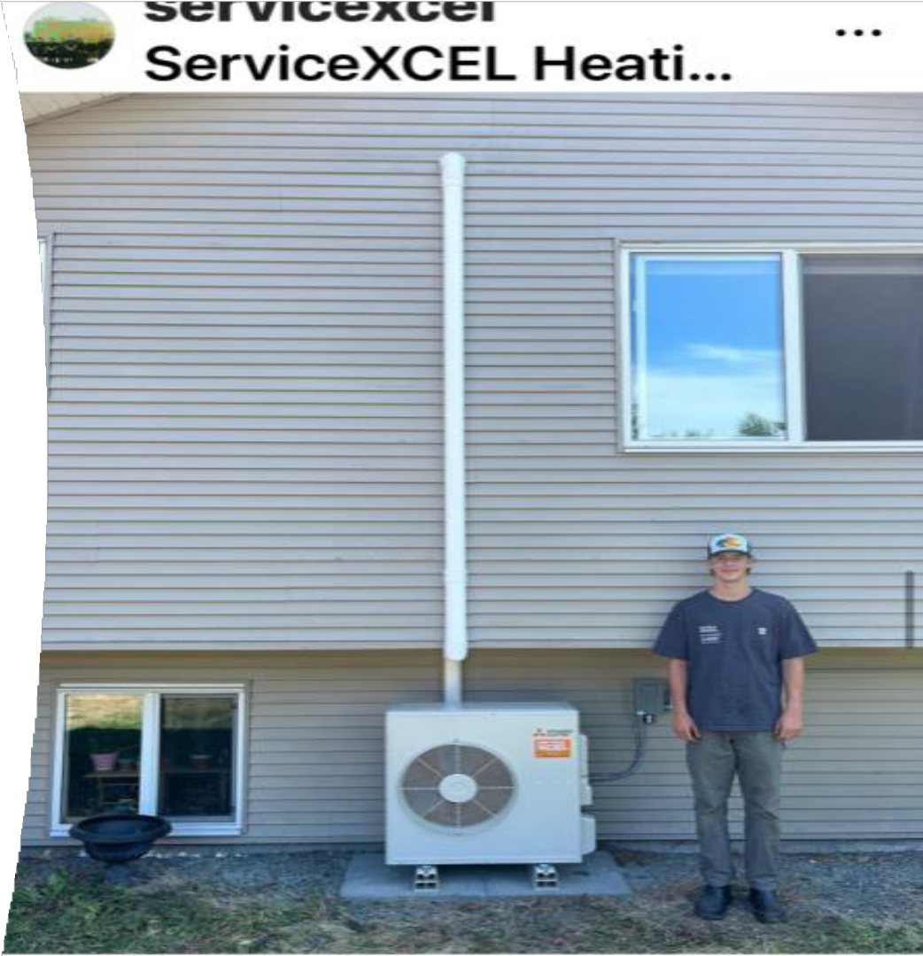
Work In Trades – Youth Apprenticeships
29 Qualicum District students signed Youth Trade Apprenticeships in 2022/23
20 so far in 2023/24
18 students received $1000 from Ministry of Education as award for reaching 900 hours for the 22/23 year
Four Ministry courses (WRK 11a/b, WRK12a/b) and 16 credits towards graduation
Ages 15-19 and employed with a sponsor
Leads directly to Dual Credit opportunity at post secondary

Slide 4
Train in Trades – Dual Credit
Qualicum School District, SkilledTradesBC (formerly known as the ITA) and the BC Ministry of Education and Child Care (ECC) have partnered to offer funding for students to complete their technical training or certificate training while enrolled as a high school student.
Students can receiv e credits towards their high school diploma and at least one lev el of technical training or foundation certification by attending training classes at one of sev eral Post Secondary Institutions that we have current MOU's with.
The Qualicum School District currently has 37 students registered in Dual Credit Programs and are forecasting that number to increase in the years to come.

Slide 5
Train in Trades – Dual Credit
Some of the programs students are enrolled in
Office Administration
Early Childhood Education & Care
Education Assistant
Health Care Assistant
Information Technology Admin. Systems
Dental Assistant
Medical Terminology
Plumbing and Pipefitting
Refrigeration and Air Conditioning Mechanic
Welding
Automotive Service Technician Professional Baking / Pastry Chef Carpentry
Culinary Arts Electrical Hairstylist
Heavy Mechanical Trades Heavy Equipment Operator
Horticulture and Landscape Architect
Motorcycle and Marine Technician

Slide 6
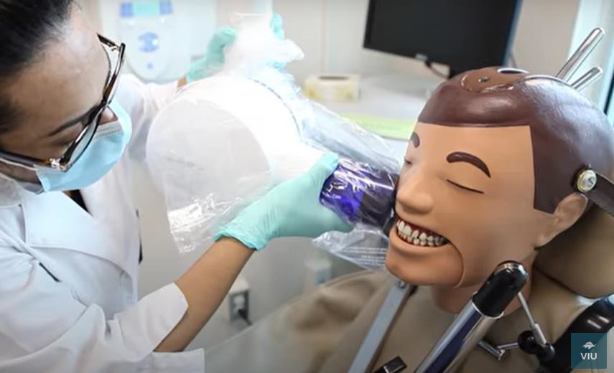
Sangeeta Dutta
Current Head Start / Dual Credit Student
Sangeeta is a current Dual Credit student studying full time at VIU in the Dental Assistant Program.
Through the Dental Assistant, Dual Credit Headstart program, all the credits Sangeeta earns in her Univ ersity Program also count as electiv e credits towards her high school Diploma.
When Sangeeta graduates from Ballenas in June, she will be earning two credentials:
A high school Diploma
AND
A Dental Assistant Certificate – with ZERO student debt, and direct employment ready

Slide 7
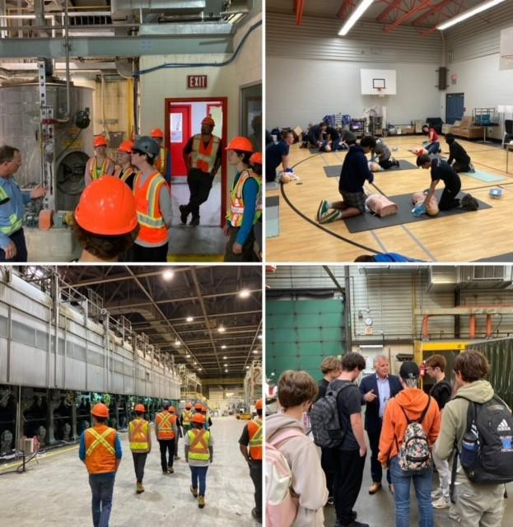
Summer Explore The Trades/Career Options July- August- 2015-2023
-Students earn certifications – First Aid, Personality Dimensions
Tour of Post Secondary Institutions- VIU/ NIC
2 Week Work Experience with chosen Trade/Career Option – WEX Credits
Summer Program bridges students to our Dual Credit program
Fire Camp – March 19-25, 2023
RCMP Camp - July 3 - 7, 2023

Slide 8
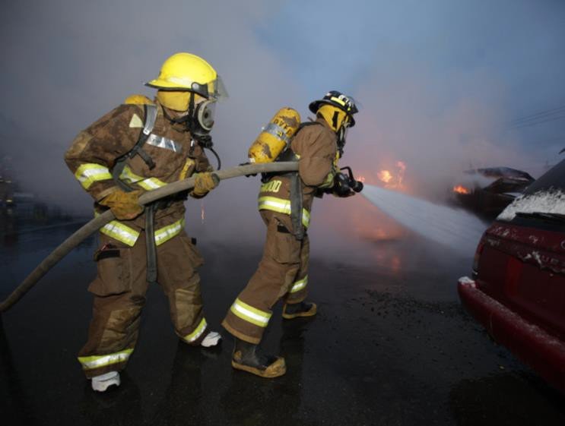
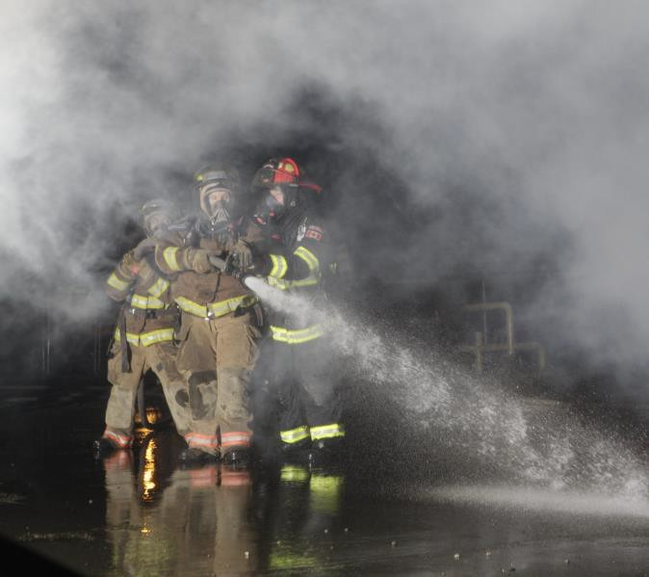
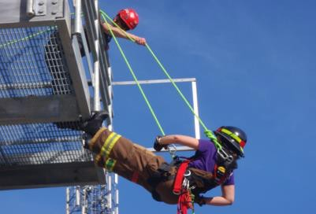
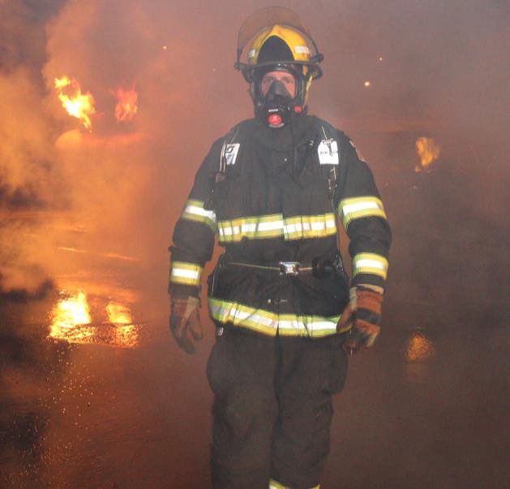
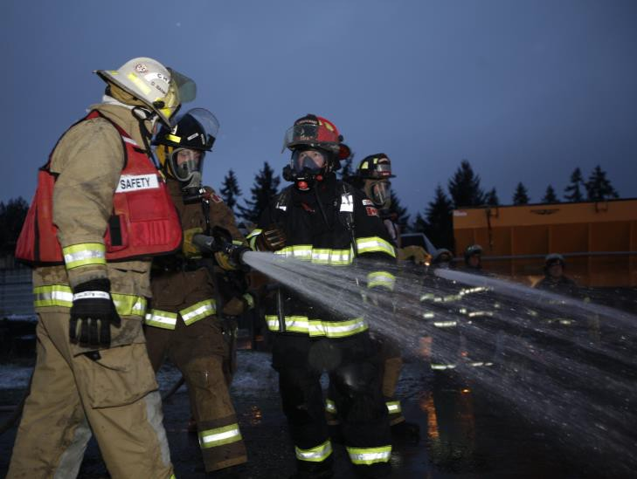
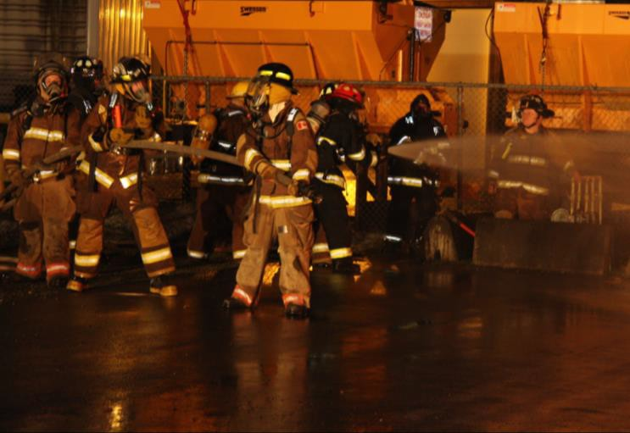

Slide 9
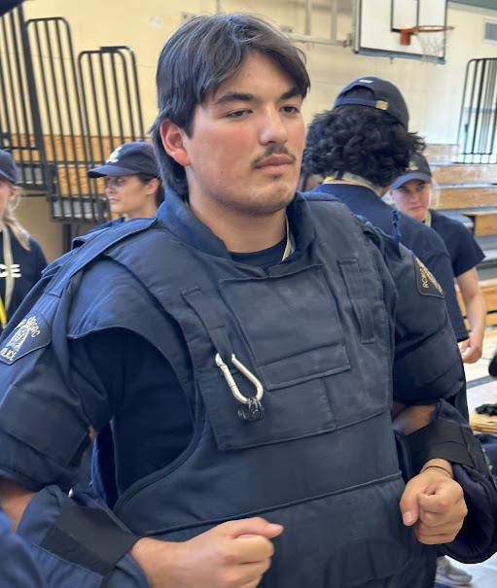
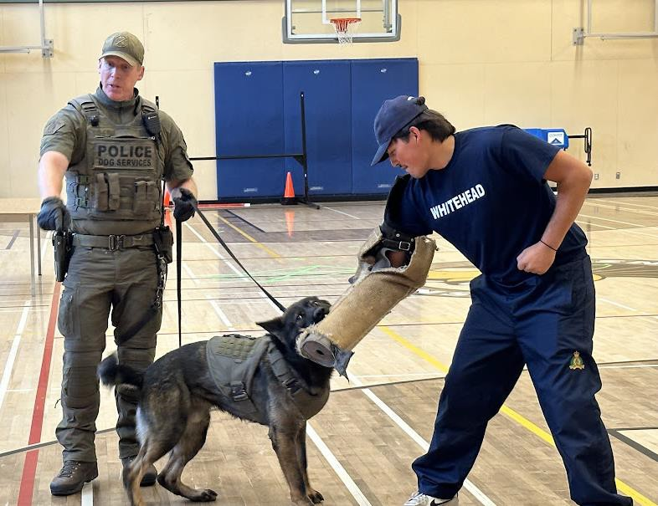
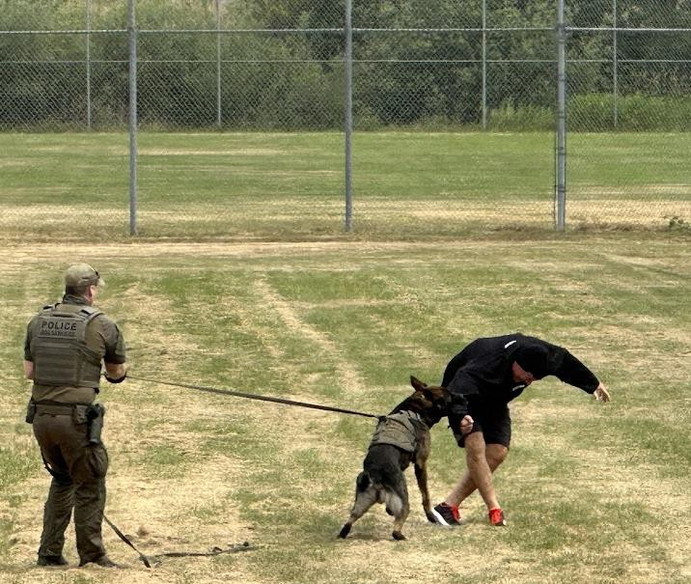
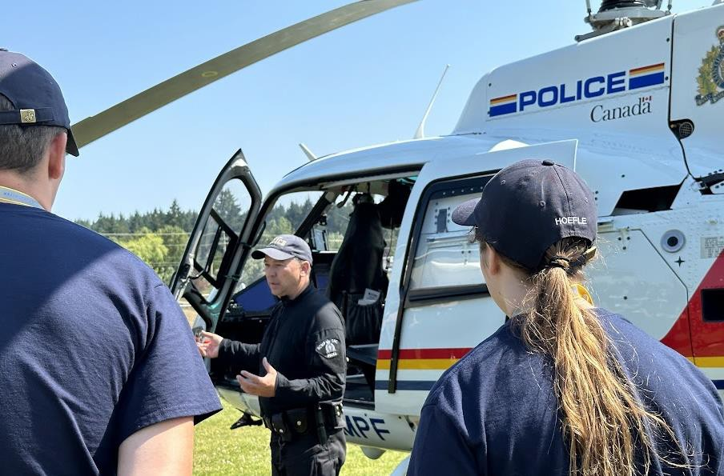

Slide 10
Elementary Career Education Support
ADST Support - Makerspace PD and Tool training
Skills Canada – Supported through District Skills Competition (February) for Grades 3 -7, Regional Competition in Campbell River (February), and Provincial Competition in Abbotsford (April)
Find Your Fit – Held @ Qualicum Beach This Year for Grade 7 Students
Cardboard Boat Challenge (May) for grades 6/7s

Slide 11
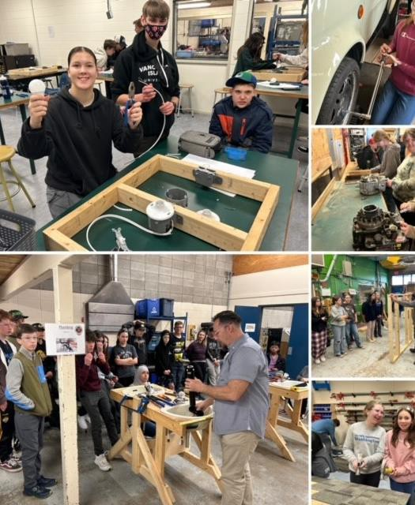
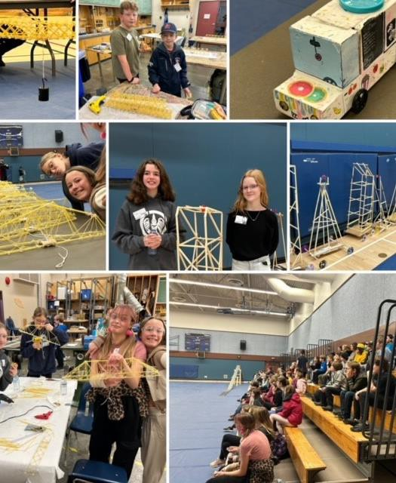

Slide 12
